Slide 1
Understanding
Hydraulic Fracturing
Presented by
Jenny Lesieutre
Assistant Deputy State Director
Bureau of Land Management
Nevada State Office
State Land Use Planning Advisory Council
May 23, 2014
Carson City, Nevada

Slide 2
Agenda
Intro to Hydraulic Fracturing
Basic Wellbore Construction
‘Fracing” Process
Public Concerns
Federal & State Regulations
Summary

Slide 3
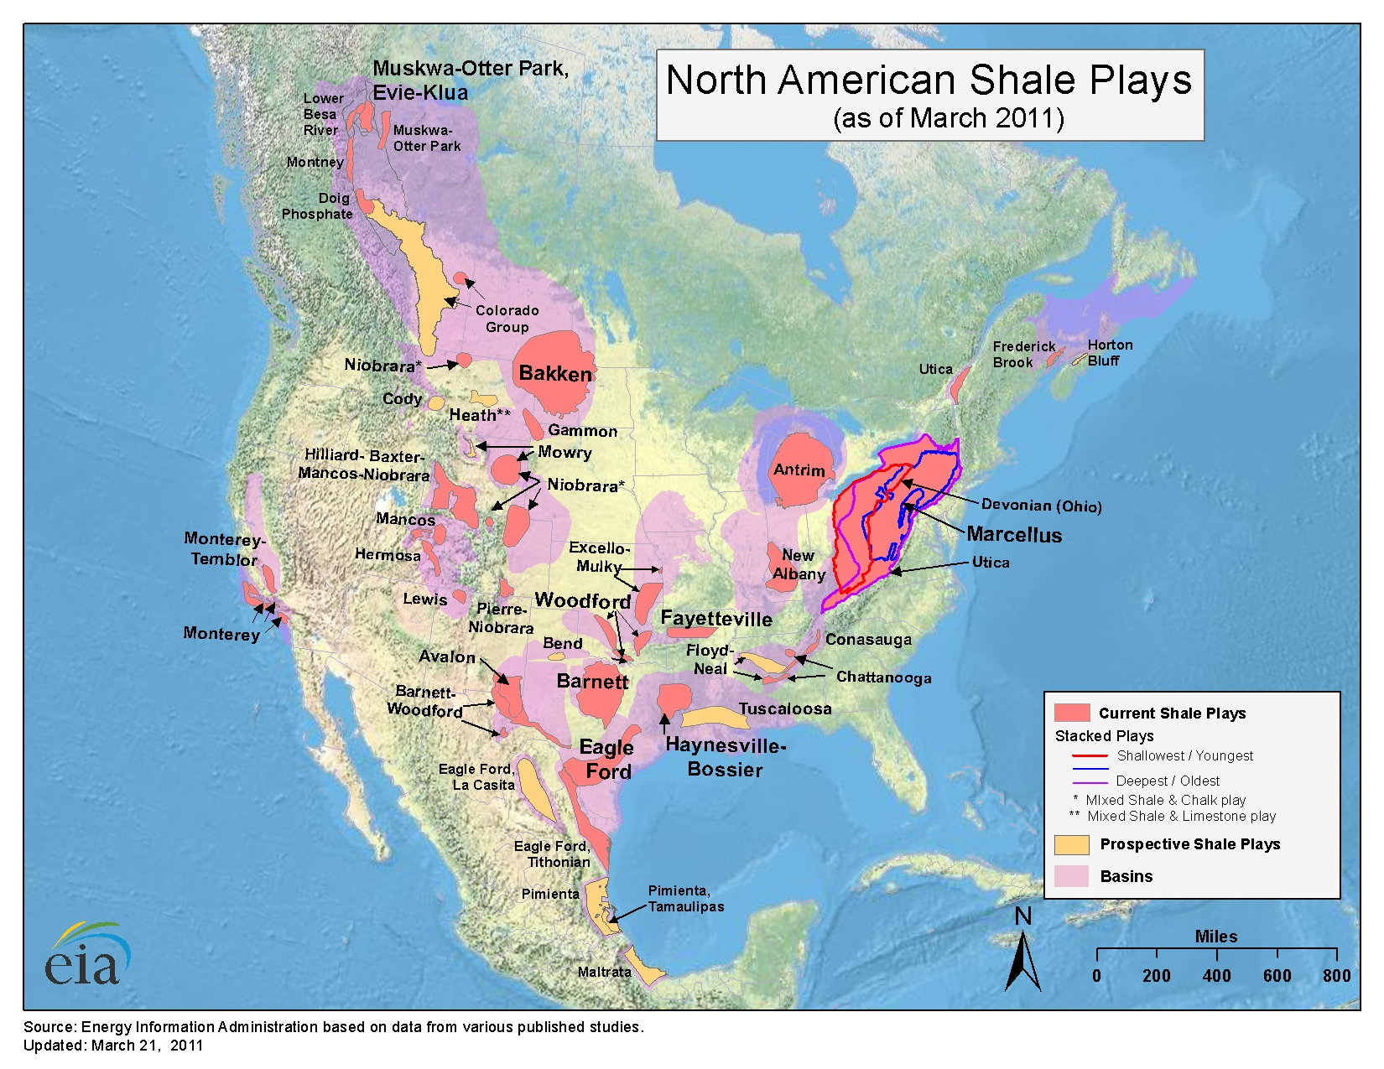
Notes:
This is just to illustrate all of the “unconventional” oil and gas plays that have become economically feasible as a result of horizontal drilling and hydraulic fracturing practices.
When I say “Unconventional”, (for those of you that are old enough to remember the sitcom “Beverly Hillbillies”), you would not be able to drill in a get an oil geyser. The days of oil flowing freely are gone – it takes another energy source to make it formation produce such as fracturing.
Simply put: the development of these “Unconventional Plays” have contributed to developing the overall resources being produced domestically reducing our dependency on foreign oil and gas.
RED/ORANGE: Currently Producing (Current Shale Plays) (NOTE the Marcellus Shale started the Domestic Trend - EAST-WEST)
PINK: Basins (areas not yet developed but within Geological Boundaries)
GOLD: Prospective Shale Plays (not yet truly explored – no development)
NOTE: Nevada does not even show a Shale Play although, over the last 10 years, Nevada BLM has been the highest leasing state – that is based on the speculations of the O&G Industry that the trend for Shale plays are going East to West as dictated in this map.
I also want to be clear - there is NO Measureable Natural Gas Market in Nevada – any production (and potential) is the thick crude oil (low quality) that is processed in refineries and less valuable than the standard Texas “Sweet Crude” Market (in other-wards it takes more volume of the NV Oil to equal the economics of the Sweet Crude)

Slide 4
Unconventional Oil and Gas “Plays”
Marcellus (Northern Appalachia – Pennsylvania, West Virginia, New York, Ohio)
  Thickness 900 feet
  Natural gas – estimated reserves 500 trillion cubic feet.
Barnett (Central Texas)
  70 % of all US gas production.
  Estimated reserves – 30 trillion cubic feet
  Natural gas
Eagle Ford (South Texas)
  Thickness 475 feet
  Both natural gas and oil
Bakken (North Dakota, Montana)
  Estimated reserves – 3.65 billion barrels, 2.0 trillion cubic feet
  Both natural gas and oil
Piceance/Uinita (Colorado, Utah)
  Thickness several thousand feet
  No measurable production yet
  Natural gas
Permian (Southeastern New Mexico, North Texas)
  19 % of the US crude oil output
  Crude oil
Niobrara (Colorado, Wyoming)
  An emerging play
  Crude oil
Elko (Northeaster n Nevada)
  Emerging shale play
  Crude oil
Notes:
Take a look at the huge numbers of production and see the value that unconventional Oil and Gas plays in today’s energy market
Nevada is currently in it’s infancy of Oil Development in the Elko formation – initial results have been promising.
There could very well be positive Social Economics Impacts should this play develop like the others above.

Slide 6
Economic Impacts
Revenue Type | Product | 2012 |  |  | 2013
 |  | Sales Volume (bbl) | Sales Value | Revenue | Sales Volume (bbl) | Sales Value | Revenue
Reported Royalties | Oil (bbl) | 374,825.49 | $33,588,879.00 | $4,194,433.66 | 331,013.34 | $28,890,712.51 | $3,661,956.85
Rents |  |  |  | $6,510,988.50 |  |  | $6,483,484.50
Bonus |  |  |  | $4,768,631.50 |  |  | $2,130,065.00
TOTALS: |  |  | $33,588,879.00 | $15,474,053.66 |  | $28,890,712.51 | $12,275,506.35
Notes:
Each county receives a portion of the revenues generated on their lands.

Slide 7
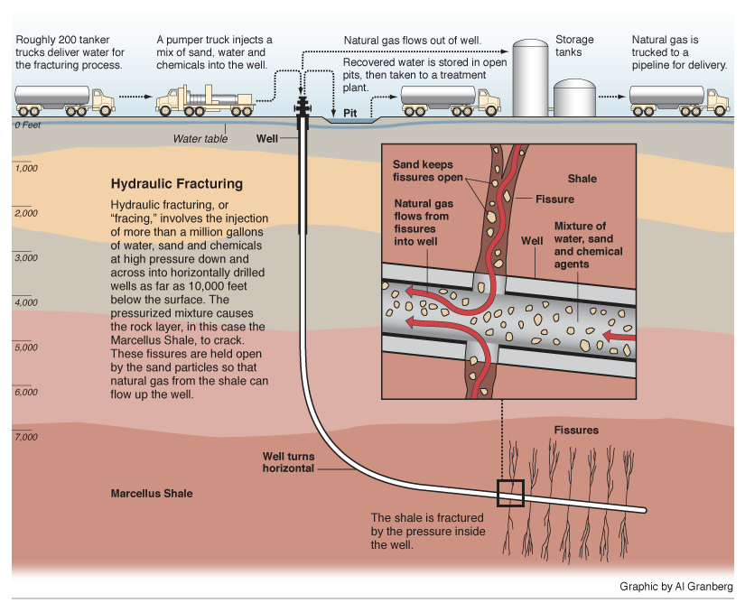
What is Hydraulic Fracturing?
Well stimulation technique that has been employed by the oil and gas industry since 1947. The technique is used to create spaces in the rock pores deep underground to release the oil and natural gas so that it can flow to the surface.
Water and additives are pumped at high pressure into the formation, creating openings that allow oil and gas to move more freely from rock where it was trapped.
Sand is also pumped with the water and it remains in the formation to hold open the rock. Most of the water and additives flow back to the surface and are disposed of safely.
Source: ProPublica
Notes:
So, let’s get to why I’m here - How Hydraulic Fracturing Works – the more surface space exposed the more “permeability” (the ability to flow) there is.
Well stimulation technique that has been employed by the oil and gas industry since 1947. The technique is used to create spaces in the rock pores deep underground to release the oil and natural gas so that it can flow to the surface.
Water and additives are pumped at high pressure into the formation, creating openings that allow oil and gas to move more freely from rock where it was trapped.
Sand is also pumped with the water and it remains in the formation to hold open the rock. Most of the water and additives flow back to the surface and are disposed of safely
**Think of this – it’s like putting a “stint” into an blocked artery allowing the blood (or this case oil) to flow more freely.

Slide 8
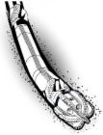
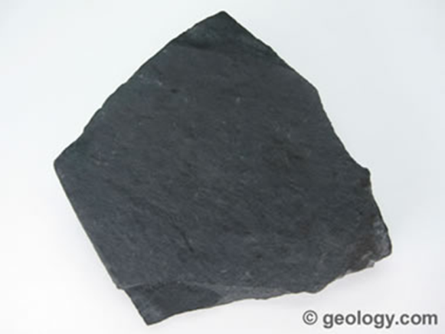
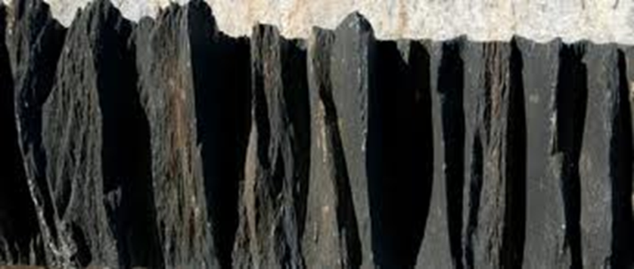
Why Hydraulic Fracturing?
Hydraulic fracturing technologies have unlocked vast new supplies of oil and natural gas for America.
The technology has also made production feasible in many areas that were previously considered too deep, too hard, and too expensive to access.
The “fracture paths” created by hydraulic fracturing, increases the surface area exposed increasing production rates up to many hundreds of percent.
Hydraulic fracturing, Multi-well pads and the possibility of Horizontal Drilling provides an environmental advantage, in that they reduce the amount of wells needed to effectively produce an oil/gas reservoir. Less wells mean less roads, less pipeline, less surface disturbance, etc.
Notes:
Hydraulic fracturing technologies have unlocked vast new supplies of oil and natural gas for America.
The technology has also made production feasible in many areas that were previously considered too deep, too hard, and too expensive to access.
The “fracture paths” created by hydraulic fracturing, increases production rates up to many hundreds of percent.
Hydraulic fracturing, Multi-well pads and the possibility of Horizontal Drilling provides an environmental advantage, in that they reduce the amount of wells needed to effectively produce an oil/gas reservoir. Less wells mean less roads, less pipeline, less surface disturbance, etc.
** Allows us to reach out further into the reservoir as opposed to moving the whole drilling rig to a new site creating more wells on the surface – expanding the “footprint”

Slide 9
Notes:
There are a lot of public concern about hydraulic fracturing and what the possible effects may be on the environment.
The following slides will address some of the concerns and hopefully help you all to better understand the level of risks to the environment.
Lets begin with the protection of surface and groundwater.

Slide 10
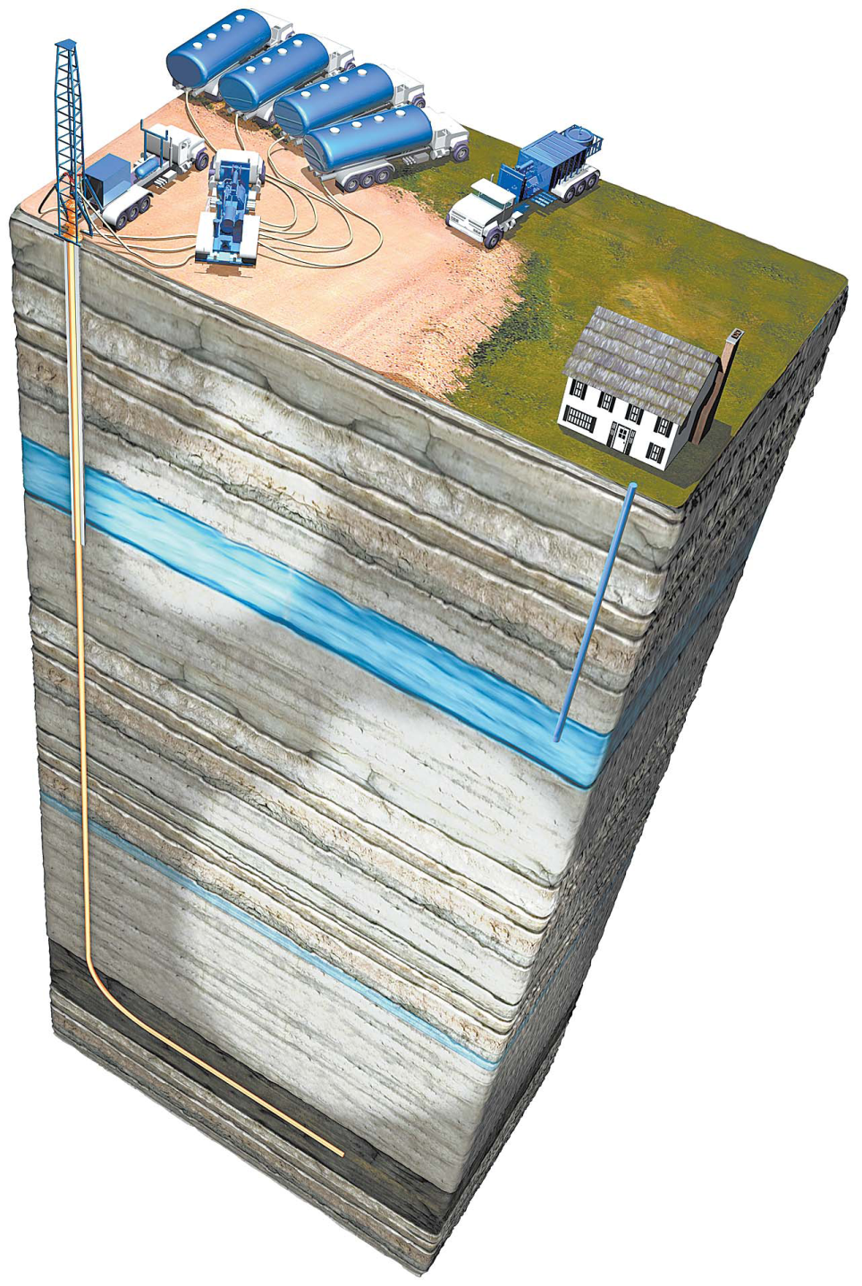
How Do We Protect Groundwater and
Surface Water from Contamination?
Well Integrity:
Design and construct the well to ensure isolation in wellbore (Hole).
Surface casing is set below useable groundwater and cemented to surface.
Intermediate and Production casing is cemented to isolate hydrocarbon zones, providing further protection to groundwater.
There are multiple layers of protective steel casing surrounded by cement.
Cement Bond Logs verify quality of cement job
Centralizers placed on the casing assures uniform cementing.
Notes:
Every well drilled on the Federal lands is designed to protect any useable water aquifers.
BLM reviews the design on all Federal leases, while the Nevada Division of Minerals reviews the wells on fee and state land.

Slide 11
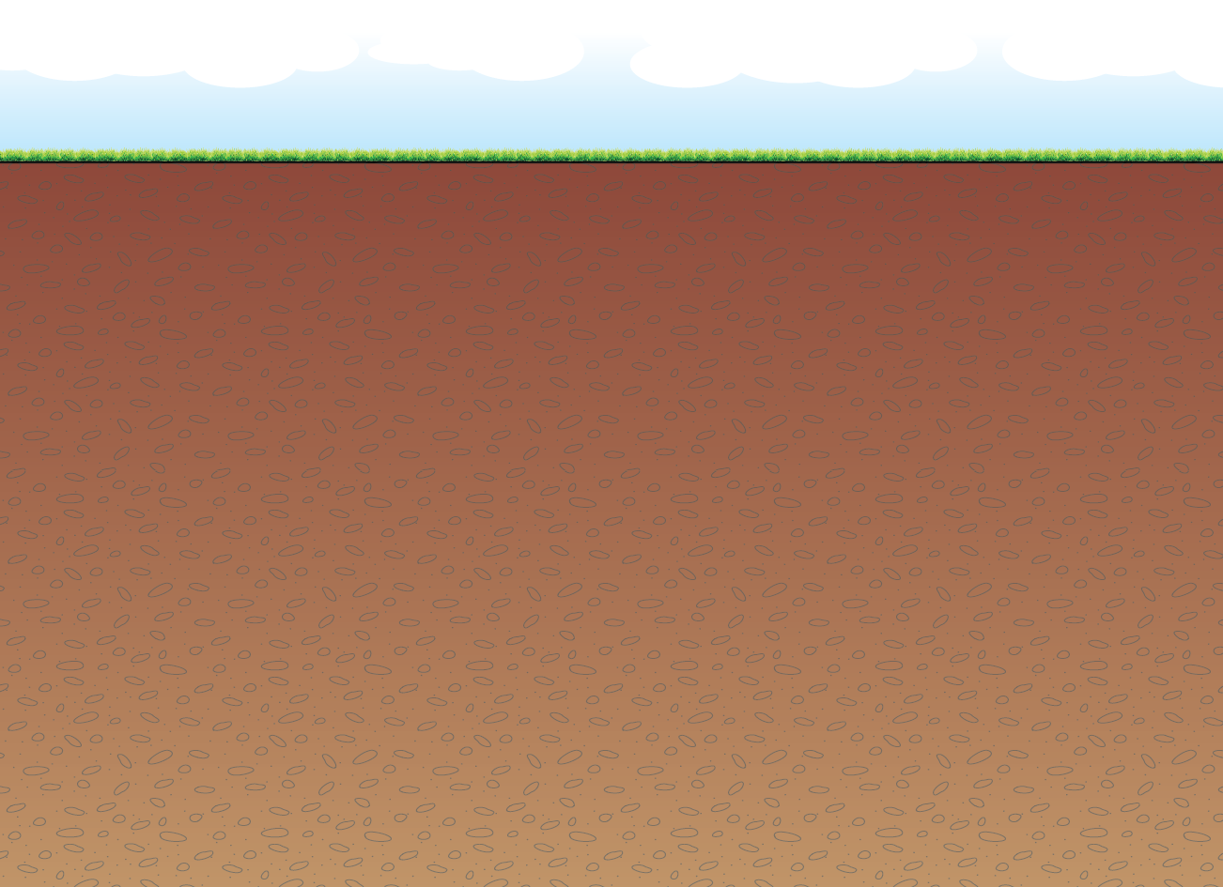
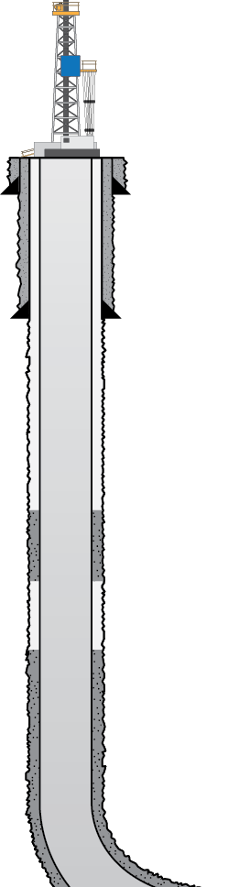


Subsurface Risks are managed by
WELL CONSTRUCTION STANDARDS
CONDUCTOR PIPE
FRESH WATER AQUIFER ZONE
SURFACE CASING
PRODUCTION CASING
Cement
SHALLOW PRODUCING ZONE
INTERMEDIATE PRODUCING ZONE
TARGET PRODUCING ZONE
Notes:
Note:
The amount of protection incorporated in ALL wells drilled. The BLM is responsible to make sure this is done according to Federal regulations. This is before ANY production occurs. Behind each of the STEEL casing is cement to stop any migration of fluid behind the casing in the hole and also adds to the stability of the hole.

Slide 12
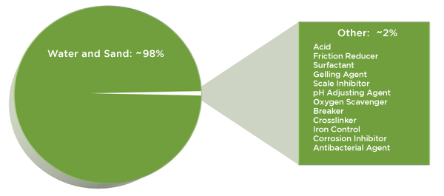
What are the Chemicals and Additives Used in the Fracturing Fluid? (FracFocus.org)
http://hydraulicfracturing.aitrk.com/Fracturing-Ingredients/Pages/information.aspx
Notes:
This graphic portrays that the majority of the fracking fluid is made up of sand and water.

Slide 13
Chemicals and Additives
Product | Main Ingredient | Purpose | Other Common Uses
_{Water} |  | Expand fracture and deliver sand. | Municipal, agricultural, manufacturing, etc.
_{Sand} |  | Props the fractures open so that oil/gas can escape. | Drinking water filtration, play sand, concrete and brick mortar.
_{Acid} | Hydrochloric acid or muriatic acid. | Helps dissolve minerals and initiate cracks in the rock. | Swimming pool chemical and cleaner.
_{Antibacterial agent} | _{Glutaraldehyde} | Eliminates bacteria in the water that produces corrosive by-products. | Disinfectant; Sterilizer for medical and dental equipment.
_{Breaker} | _{Ammonium persulfate} | Allows a delayed breakdown of the gel. | Used in hair coloring, as a disinfectant, and in the manufacture of common household plastics.
_{Crosslinker} | _{Borate salts} | Maintains fluid viscosity as temperature increases. | Used in laundry detergents, hand soaps and cosmetics.
_{Gel} | Guar gum or hydroxyethyl cellulose | Thickens the water in order to suspend the sand. | Thickener used in cosmetics, baked goods, ice cream, toothpaste, sauces and salad dressings.
_{Clay stabilizer} | _{Potassium chloride} | _{Creates a brine carrier fluid.} | Used in low-sodium table salt substitute, medicines and IV fluids.
_{pH adjusting agent} | _{Sodium or potassium carbonate} | Maintains the effectiveness of other components, such as crosslinkers. | Used in laundry detergents, soap, water softener and dishwasher detergents.
_{Scale inhibitor} | _{Ethylene glycol} | Prevents scale deposits in the pipe. | Used in household cleaners, de-icer, paints and caulk.
_{Surfactant} | _{Isopropanol} | Used to increase the viscosity of the fracture fluid. | Used in glass cleaner, multi-surface cleaners, antiperspirant, deodorants and hair color.
Notes:
This slides discuss the common chemicals and additives. While it may not be appropriate to go through every row, I would concentrate on the other common uses. A lot of these chemicals can be found in our homes or everyday household products.

Slide 14
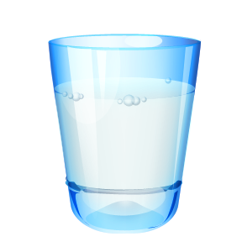
Chemicals and Additives
Mitigation Requirements
Wellbore integrity isolates fracture fluids.
Fluid that is returned to the surface is adequately stored in lined pits or steel tanks until proper disposal.
Material handling on the surface is in accordance with requirements and long-standing industry practices.
All chemicals used have Material Safety Data Sheets (MSDS) available for review on well site.
Notes:
When the fluid flows back to the surface, it is important that the fluid is contained. In most instances, the oil and gas operator would contain this fluid in steel tanks. If it is flowed into an earthen pit on location, that pit would need to be lined and earthen berms would be constructed around the pit as an additional caution to prevent overflow.

Slide 15
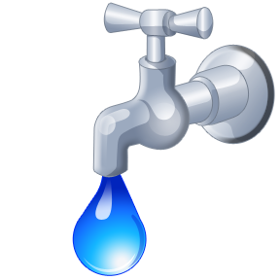
What are the Water Volumes Used?
Typically, 150,000 – 400,000 gallons needed for fracture stimulation. 30-40% of this will return to surface.
Mitigation Measures
The amount of new water can be reduced when fracture fluids are recycled.
Other water use should be considered with respect to current water uses (i.e. agricultural, municipal, power generation, etc.).
Notes:
Water volumes are based on what we know now for this general area. May change with continued development.
lets put the water volume in perspective
A typical Hydraulic Fracture job uses roughly the same amount of water as watering a golf course for two days –

Slide 16
What is Done with The Fluid that comes back to the Surface?
Mitigation Requirements
Disposal -
Treatment/Reuse.
Underground injection well.
Commercial disposal facilities.
Surface evaporation pits or ponds.
Notes:
These are the four basic options that exist now for fluid disposal. Treatment/Reuse is clearly the best option; however, these types of systems usually are not employed until the oil and gas operator is in the development phase. Prior to approving a hydraulic fracturing job, the oil and gas operator must display an acceptable plan to dispose of the spent fracturing fluid.

Slide 17
What is The Next Step?
Proposed Federal Regulations to Address Hydraulic Fracturing
  On May 11, 2012 the Bureau of Land Management (BLM) published in the Federal Register a proposed rule entitled Oil and Gas, Well Stimulation, Including Hydraulic Fracturing, on Federal and Indian Lands.
  On May 16, 2013, the U.S. Interior Department’s Bureau of Land Management (BLM) issued a draft proposal for regulating hydraulic fracturing activities on Federal and Indian Lands.
Notes:
The proposed regulation are trying to clarify routine and non-routine frac jobs

Slide 18
What is The Next Step?
State of Nevada, Nevada Division of Minerals
  In the 2013 Legislative session, SB390 required the Division of Minerals and the Division of Environmental Protection to jointly develop a hydraulic fracturing program to:
    Assess the effects of hydraulic fracturing on the waters of the state of Nevada.
    Requires a person who engages in hydraulic fracturing to disclose each chemical used. (FracFocus.org)
    Provide for notice to members of the general public concerning activities relating to hydraulic fracturing in the state.

Slide 19
Summary
The Federal Bureau of Land Management in concert with State of Nevada place great emphasis on protecting groundwater.
Current well construction requirements consist of installing multiple layers of protective steel casing surrounded by cement. These elements are specifically designed and installed to protect freshwater aquifers.
The measures required by both State and Federal regulatory agencies in the exploration and production of deep shale formations have been very effective in protecting drinking water aquifers from contamination attributable to hydraulic fracturing, or fracing.
Based on scientific available data of state and Federal agencies, there is not a documented case of drinking water contamination related to hydraulic fracturing.
Furthermore, the Ground Water Protection Council (GWPC) issued a report in April of 2009 stating that the potential for fracing deep shale wells to impact groundwater is extremely remote, as low as one in 200 million.
Notes:
Please keep in mind we are not here to convince you that Hydraulic fracturing is good nor is it bad. We have presented the information needed to learn about the process, the concerns and the ultimate outcome – good, bad or otherwise.
We have many specialist that you can call and speak with. There are large numbers of reports from every angle imaginable concerning Hydraulic Fracing.
Type in Hydraulic Fracturing on the worldwide web -computer and see how many articles and peoples personal comments show up. This technology is not new it been around since 1957, but people are taking a closure look into the impacts it might have on the lands.
We are asking you to learn the technology and read article and determine is this right for the people of my county.
Thanks You

Slide 20
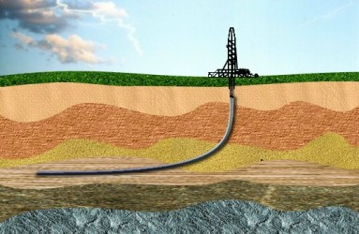
Questions?

